Slide 1
Case Study:
Beer and Breweries of the United States
Team Data Junkies
Chris Roche, Puri Rudick, Ryan Kinney

Slide 2
Outline
Data Overview
Brewery Locations Across the Country
Alcohol By Volume (ABV)
International Bitterness Units (IBU)
IPAs and Other Types of Ale
Various Sizes of Beer Containers by State
Notes:
443434

Slide 3
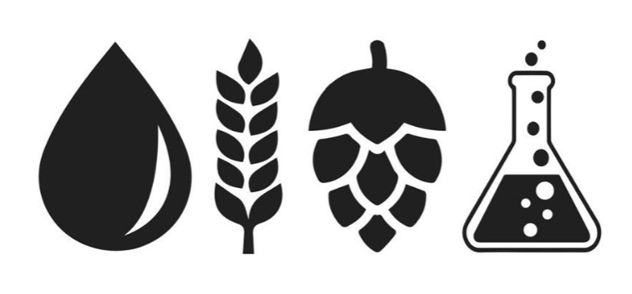
Missing Values in the Datasets
A summary of the missing data in the beer datasets:
ABV has 62 missing values,
IBU has 1005 missing values, and
Style has 5 missing values
All South Dakota beers are missing IBU value
Team Data Junkies filtered observations with missing values out of the dataset before performing exploratory data analysis

Slide 4
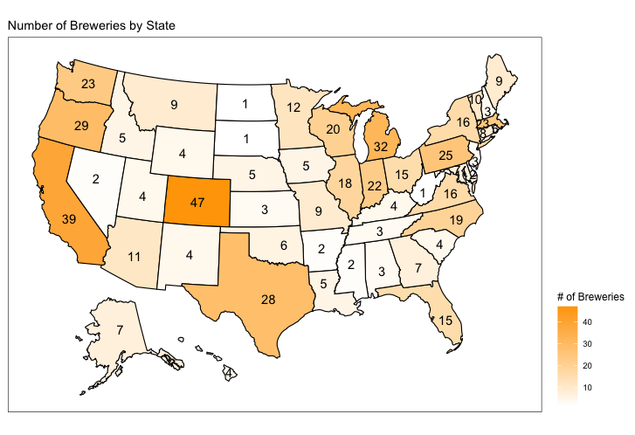
Breweries of the United States
Quick Facts:
Colorado has the most breweries, 47
Out of the top 5 states with the most breweries, 3 are in the West Coast
West Virginia, North Dakota, and South Dakota each have only one brewery
Missouri (the home of Anheuser-Busch & Budweiser) has 9 breweries
Ranks 20th

Slide 5
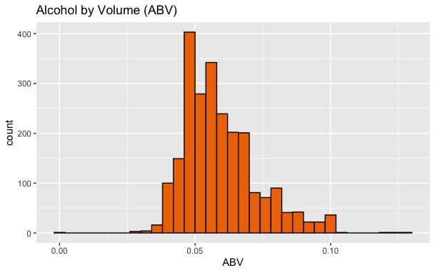
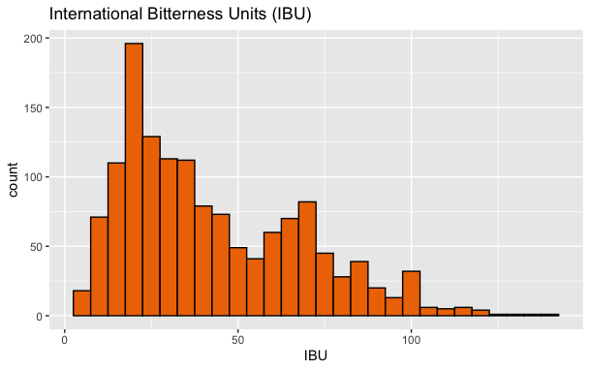
Alcohol By Volume (ABV) and International Bitterness Units (IBU)
ABV’s in the dataset range from a minimum of 0.1% to a maximum of 12.8%
The average ABV is 6% with a standard deviation of 1.4%
IBU’s in the dataset range from 4 to 138
The average IBU is 43 with a standard deviation of 26

Slide 6
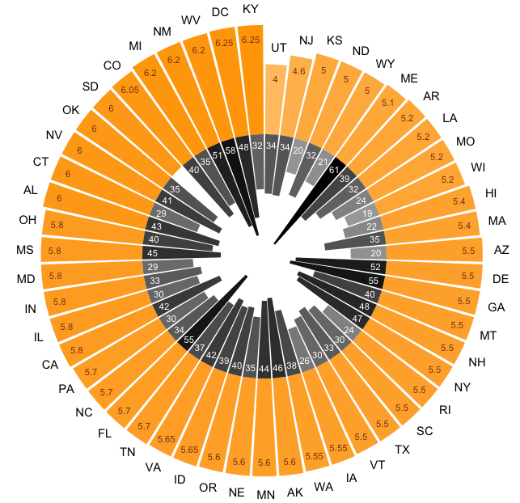
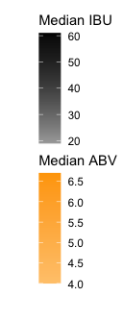
The Most Alcoholic and Bitter Beers
On average:
DC and Kentucky have the most alcoholic (6.25%)
Maine has the most bitter beers (61 IBU)
By individual beers:
Colorado has the highest ABV beer at 12.8%
Lee Hill Series Vol. 5 by Upslope Brewing Company
Oregon has the most bitter beer at an IBU of 138
Bitter B**** Imperial IPA by Astoria Brewing Company
* The bar chart ordered clockwise by median ABV value
** The darker color represents higher value of median ABV and IBU

Slide 7
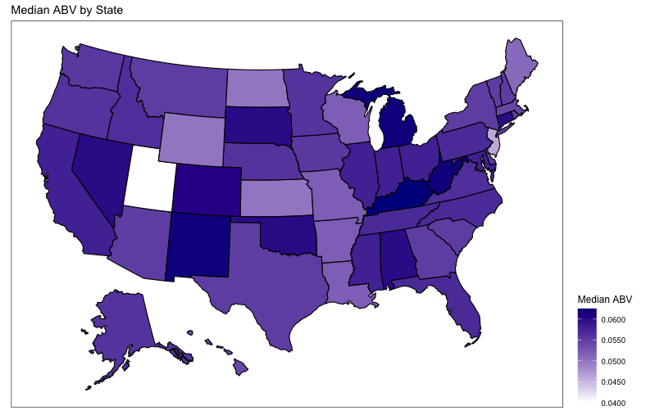
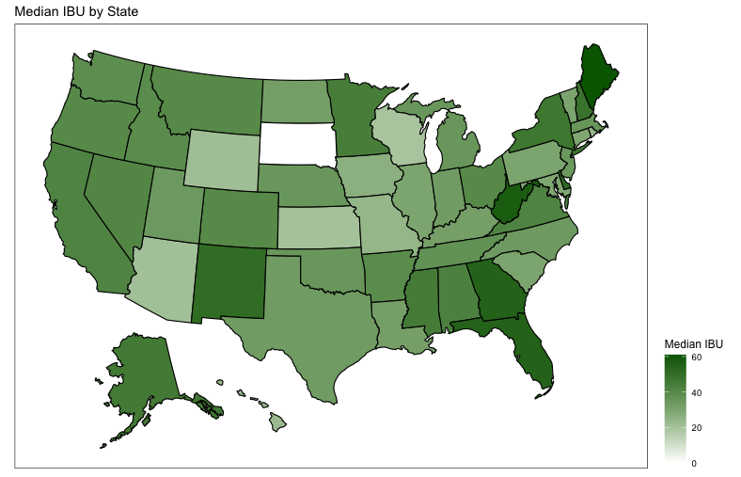
Regional Distributions of ABV and IBU
There are no clearly defined patterns to suggest any one region of the United States prefers more bitter (higher IBU) or stronger (higher ABV) beer.
Utah and Arkansas had laws until 2020 limiting the alcohol content of beer.
Recall South Dakota has a lack of IBU data.

Slide 8
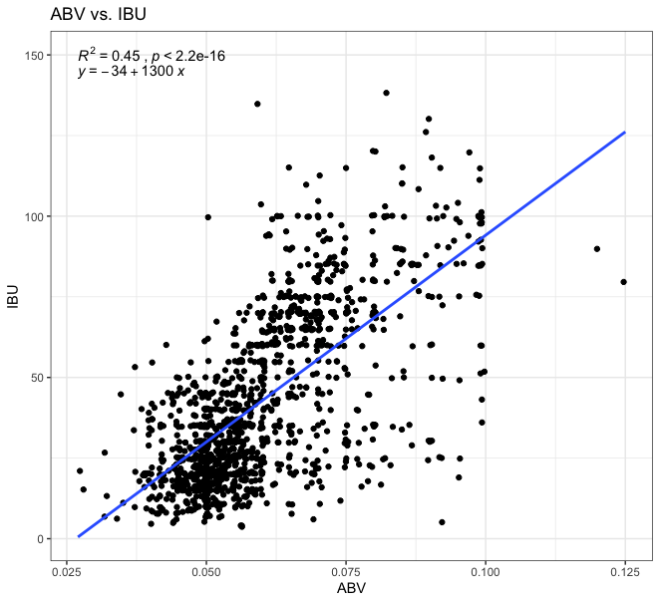
The Relationship Between ABV and IBU
A scatterplot was created to plot the relationship between ABV and IBU.
There is a positive relationship, suggesting that as IBU rises so to does ABV.

Slide 9
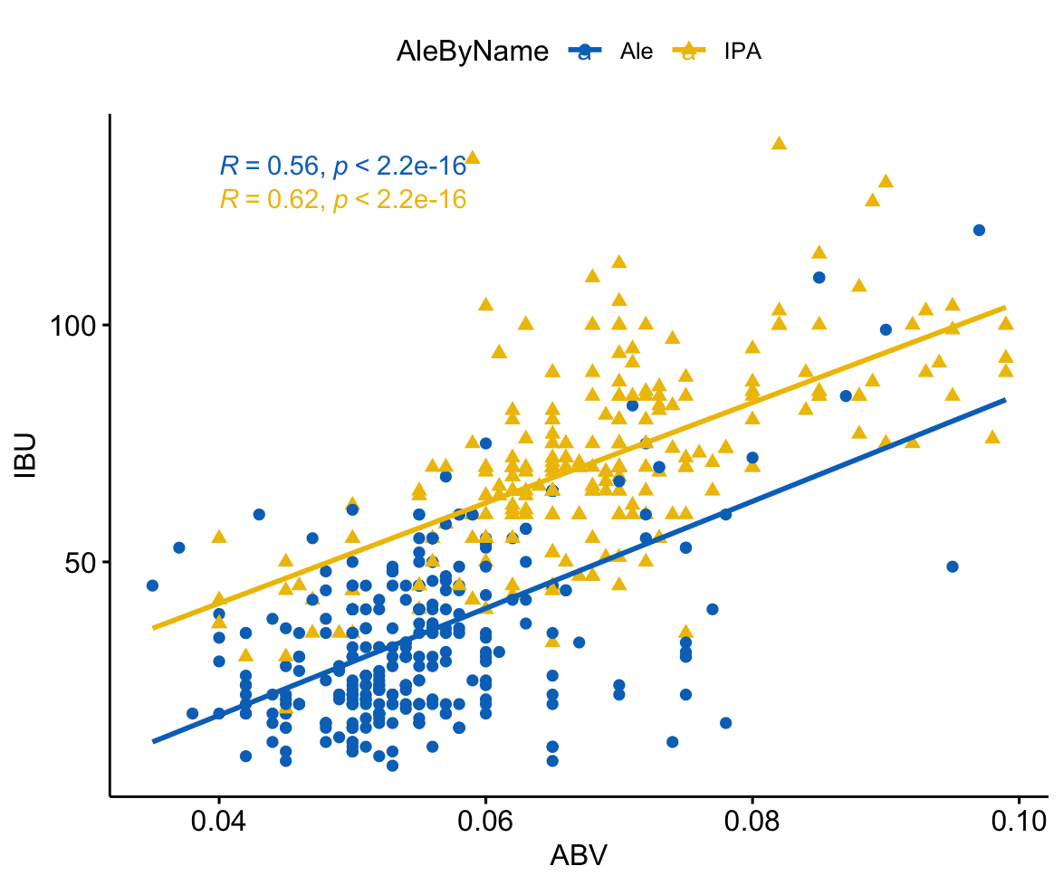
ABV and IBU between IPAs and Other Types of Ale
Both IPAs and other types of Ale have positive relationship between ABV and IBU
kNN Classification:
Accuracy: 86%
Sensitivity: 90%
Specificity: 81%

Slide 10
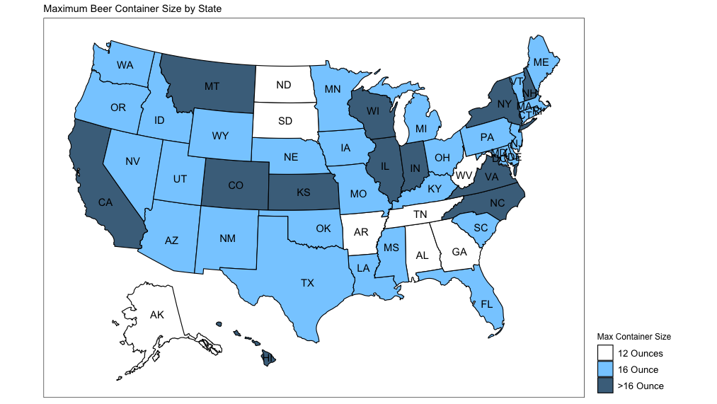
Maximum Beer Container Size by State
There are 9 states where the biggest beer container size is only 12 ounces
Alaska, Alabama, Arkansas, DC, Georgia, North Dakota, South Dakota, Tennessee, and West Virginia
Good business opportunity for Budweiser to launch larger sized products in select markets

Slide 11
Summary
CO, CA, OR, TX, and WA are states that has the most breweries, respectively
Average ABV is 6%, range between 0.1% to 12.8%
Average IBU is 43, range between 4 to 138
ABV and IBU has positive relationship
kNN Technique can be used to classify beer types with high % accuracy
9 States to be considered launching larger sized products

Slide 12
Thank you

Slide 13
Backup

Slide 14
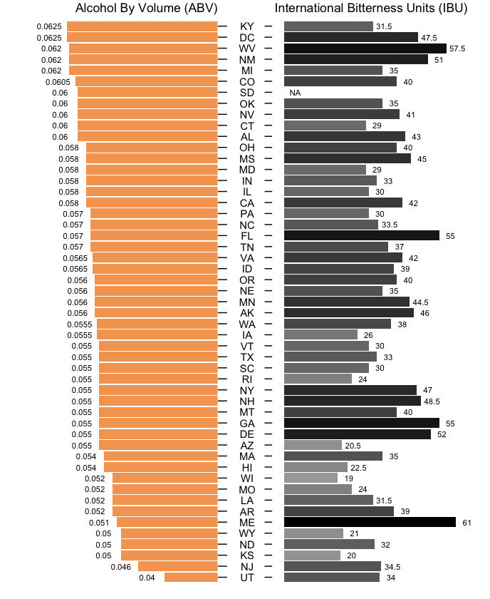
Alcohol By Volume (ABV)
and International Bitterness Units (IBU) for Each State

Slide 15
The Relationship Between ABV and IBU
 | Estimate | Std. Error | T value | P value
IBU (intercept) | -34.068 | 2.327 | -14.64 | < .0001
ABV | 1281.861 | 37.871 | 33.85 | < .0001
95% CI Slope = (1207.57, 1356.15)
95% CI Intercept = (-38.63, -29.50)

Slide 16
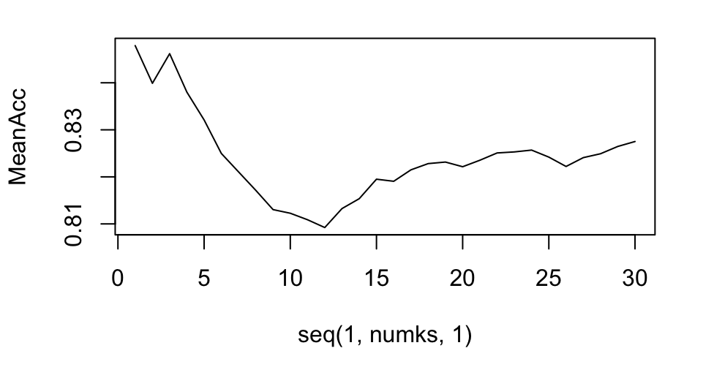
KNN Classification for ABV and IBU between IPAs and Ale
k = 3 gives the highest percent of accuracy, which is ~86%
 | k = 3 | k = 5 | k = 7
Accuracy | 86% | 82% | 82%
Sensitivity | 90% | 86% | 81%
Specificity | 81% | 78% | 83%

